Slide 1
NASAL CAVITY
BY
DR OJEWALE A.O

Slide 2
Outline
Intro’
Parts (Vestibule and Nasal cavity proper)
Conchae
Meatuses
Lining of nasal cavity
Arterial supplies
Venous drainage
Lymphatic drainage
Applied anatomy

Slide 3
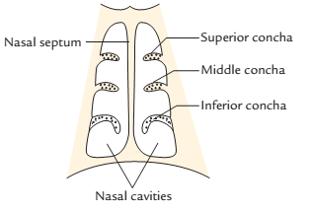
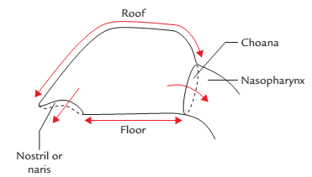
NASAL CAVITY
The interior of the nose is divided into right and left nasal cavities by a nasal septum.
Each nasal cavity communicates with the exterior via the anterior nasal aperture (nostril) and with the nasopharynx through the posterior nasal aperture (or the choana)
Division of the internal nose into right and left nasal cavities

Slide 4
Cont’d
Each nasal cavity is divided into two portions: (a) a small anteroinferior part lined by skin-the vestibule and (b) a large posterosuperior part lined by mucosa-the nasal cavity proper.
Each nasal cavity receives the openings of the paranasal sinuses.

Slide 5
VESTIBULE OF NOSE
It is the anteroinferior part of nasal cavity, lined by skin. The skin contains sebaceous glands, hair follicles, and the stiff interlacing hair called vibrissae. It is limited above by the limen nasi on the lateral wall of the vestibule of the nasal cavity (produced by the upper margin of the major alar cartilage) . Its medial wall is formed by a mobile columella.
It is bounded laterally by the ala and parts of the alar cartilages and medially by the septal process of the major alar cartilage.

Slide 6
NASAL CAVITY PROPER
The nasal cavity proper presents the following boundaries:
Roof.
Floor.
Medial wall (septum).
Lateral wall.
Roof: The roof is very narrow in front and widens to about 1 cm near the choana. It is horizontal in the middle third, where it is formed by the cribriform plate of the ethmoid. The roof of the nasal cavity proper has three parts; these are, from behind forwards, the sphenoidal, ethmoidal, and frontonasal parts.
.

Slide 7
Cont’d
The sphenoidal part of nasal roof is formed by the anterior surfaces of the body of the sphenoid, this part slopes downwards and backwards and receives the opening of the sphenoidal sinus.
The ethmoidal part of nasal roof is formed by the cribriform plate of ethmoid; it is horizontally-disposed and bears several foramina, which connect the nasal cavity with the anterior cranial fossa (and which transmit the olfactory nerve).

Slide 8
Cont’d
The frontonasal part of nasal roof is formed by the nasal spine of the frontal, the nasal bone and the junction of the septal and lateral cartilages; it slopes downwards and forwards
Intimately related (above) to the roof of the nasal cavity are the sphenoidal sinus and anterior cranial fossa, the anterior cranial fossa contains the olfactory bulb, frontal lobes of the cerebral hemispheres, and meninges.

Slide 9
Cont’d
Floor: It is formed by the upper surface of the hard palate, i.e., anterior three-fourth is formed by palatine process of maxilla and posterior one fourth is formed by the horizontal plate of the palatine bone. The floor is almost horizontal. It slopes downwards and forwards, and is broader than the roof. It bears the opening of the incisive canal in its anterior part (near the nasal septum).

Slide 10
Cont’d
Medial wall: It is formed by nasal septum. The nasal septum is a median osseocartilaginous partition between the nasal cavities. It extends from the nasal roof above to the floor below.
The bony part is formed by: perpendicular plate of ethmoid, which forms the posterosuperior part of the septum, and vomer, which forms the posteroinferior part of the nasal septum, including the posterior border of the nasal septum. This bone extends from the sphenoidal body above to the hard palate below.

Slide 11
Cont’d
The cartilaginous part is formed by septal cartilage, which forms the major anterior part of the septum and fits in the angle between the vomer and perpendicular plate of ethmoid, and septal processes of the two major alar cartilages.
The hyaline septal cartilage completes the nasal septum anteriorly.
Minor contributions to the nasal septum are provided by the nasal spine of frontal bone anterosuperiorly, sphenoidal crest posterosuperiorly, and the nasal crest of maxilla, and the palatine bone inferiorly.

Slide 12
Cont’d
The nasopalatine nerve and sphenopalatine vessels groove the surface of the vomer as they pass anteroinferiorly over the septum.

Slide 13
Cont’d
Lateral wall: It has an irregular appearance, owing to the presence of three scroll-like bony processes (superior, middle, and inferior conchae) that project inferomedially from it. It is formed by a number of bones and cartilages.
It is separated from the orbit (in its upper part) by the ethmoidal labyrinth.
It is formed mainly by three bones, which include maxillary, palatine, and ethmoidal bones.
It is also formed by the maxilla antero-inferiorly, perpendicular plate of palatine bone posteriorly, and ethmoidal labyrinth superiorly.

Slide 14
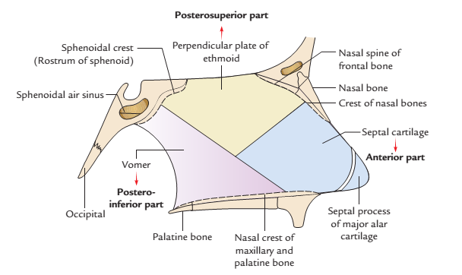
Cont’d
Formation of the nasal septum

Slide 15
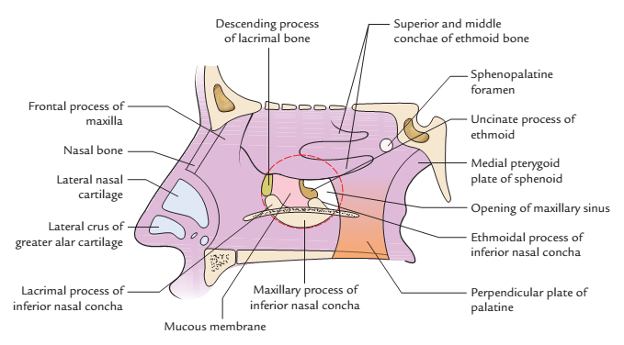
Cont’d
The cartilages forming the lateral wall are: lateral nasal cartilage (upper nasal cartilage), major alar cartilage (lower nasal cartilage), and three to four tiny cartilages of the alae (minor alar cartilages).
Formation of the lateral wall of the nasal cavity

Slide 16
Features of the lateral wall
The lateral wall is divided into the following three areas: Anterior part presents a small depressed area, the vestibule. It is lined by the skin containing vibrissae (short, stiff curved hair). Middle part is known as atrium of the middle meatus. It is limited above by a faint ridge of mucous membrane, the agger nasi. The curved mucocutaneous junction between the atrium and vestibule is known as limen nasi. Posterior part presents three scroll-like projections, the conchae or turbinates. The spaces separating the conchae are called meatuses.

Slide 17
Cont’d
The conchae and meatuses form the main features of the lateral wall: Conchae (are the curved bony projections directed downwards and medially. Below and lateral to each concha is a corresponding meatus. From above downwards the conchae are superior, middle, and inferior nasal conchae.

Slide 18
Conchae:
Superior nasal concha is the smallest of the conchae, It is located adjacent to the sphenoidal body. Superior and middle nasal conchae are the projections from the medial surface of the ethmoidal labyrinth. Superior nasal concha separates the sphenoethmoidal recess above from the superior nasal meatus below.
The middle nasal concha is located above the inferior nasal concha, on the lateral wall of the nasal cavity, and it overhangs the middle nasal meatus.

Slide 19
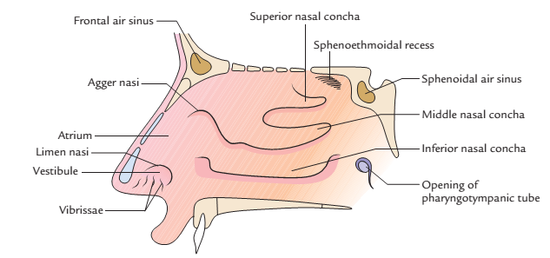
Cont’d
Inferior nasal concha is a separate bone and it is also the largest of the conchae. It is close to the nasal floor and it overhangs the inferior nasal meatus. Being a separate bone, the inferior concha articulates with the maxillary and palatine bone.

Slide 20
Meatuses
Meatuses are the passages (recesses) beneath the overhanging conchae. The superior nasal meatus is located beneath the superior nasal concha; it is the shallowest and shortest of the nasal meatuses. It receives the opening of the posterior ethmoidal sinus.
The middle nasal meatus lies beneath the middle nasal concha, which largely hides it from view. On its lateral wall is the rounded ethmoidal bulla-an eminence produced by the middle ethmoidal air cells.

Slide 21
Cont’d
Just anteroinferior to the ethmoidal bulla, on the lateral wall of the middle nasal meatus, is a curved narrow process- the uncinate process of ethmoid. Between the uncinate process of ethmoid below, and the ethmoidal bulla above, is a curved groove termed the hiatus semilunaris (on the lateral wall of middle nasal meatus).
At the upper end of the hiatus semilunaris is the opening of the ethmoidal infundibulum, a narrow funnel-shaped canal into which the anterior ethmoidal air cells, and the frontal sinus open..

Slide 22
Cont’d
Occasionally, the ethmoidal infundibulum ends blindly; in this instance, the frontal sinus opens, via the frontonasal duct, into the hiatus semilunaris.
The maxillary sinus opens into the lower end of the hiatus semilunaris through a large ostium.
The middle ethmoidal sinus opens into middle nasal meatus on or above the ethmoid bulla.

Slide 23
Cont’d
The inferior nasal meatus is located inferolateral to the inferior nasal concha; it is the largest of the nasal meatuses, reaching as far down as the nasal floor.
It receives the opening of the nasolacrimal duct in its anterior part.
The sphenoethmoidal recess is a triangular depression, and the narrow part of the nasal cavity located between the superior nasal concha below, and the sphenoidal body above. It receives the opening of the sphenoidal sinus.

Slide 24
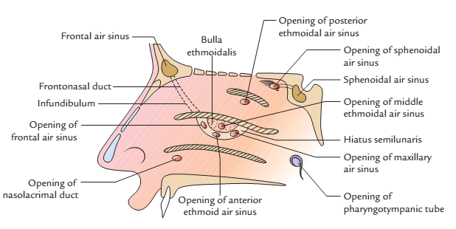
Cont’d
Lateral wall of the nose with conchae removed showing openings of various sinuses and nasolacrimal duct.

Slide 25
The openings in the lateral wall of the nose
Sites | Openings
Sphenoethmoidal recess | Opening of the sphenoidal air sinus
Superior meatus | Opening of the posterior ethmoidal air sinuses
Middle meatus
•On bulla | Opening of the middle ethmoidal air sinuses
• In hiatus semilunaris | Opening of the middle ethmoidal air sinuses
Anterior part | Opening of the frontal air sinus
Middle part | Opening of the anterior ethmoidal air sinuses
Posterior part | Opening of the maxillary air sinus
Inferior meatus | Opening of the nasolacrimal duct (in the anterior part of meatus)

Slide 26
Lining of Nasal Cavity
The lining of the various regions of nasal cavity are as follows:
Vestibule: It is lined by the skin containing a large number of sebaceous glands and interlacing coarse hair-the vibrissae. As the air passes through the nostrils, the large particles of dust in the air are trapped by the vibrissae.

Slide 27
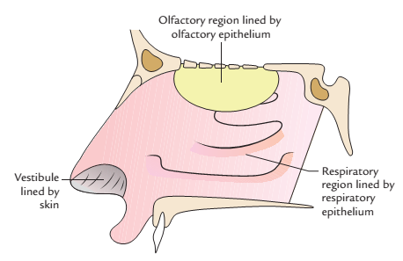
Cont’d
Lining of the nasal cavity

Slide 28
Olfactory region: The upper third of the nasal cavity bounded above by cribriform plate of ethmoid, laterally by superior nasal concha and medially by upper one-third of the nasal septum forms the olfactory region. It is lined by the olfactory epithelium, which contains receptor cells for smell.
Respiratory region: The rest of the nasal cavity (lower two-third) is lined by the respiratory epithelium, i.e., pseudostratified ciliated columnar epithelium with goblet cells. The respiratory mucosa is highly vascular and contains a large number of cavernous spaces and sinusoids to warm the air. In addition, it contains a large number of serous and mucous glands.

Slide 29
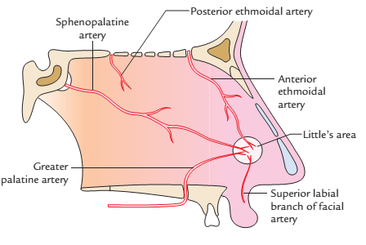
Arterial supply of the nasal septum

Slide 30
Arterial Supply of Nasal Septum
Septal branch of the anterior ethmoidal artery (a branch of ophthalmic artery).
Septal branch of the posterior ethmoidal artery (a branch of ophthalmic artery).
Septal branch of the sphenopalatine artery (a branch of maxillary artery).
Septal branch of the greater palatine artery (a branch of maxillary artery).
Septal branch of the superior labial artery (a branch of facial artery).

Slide 31
Nerve Supply of Nasal Septum
Olfactory nerves supply the upper part (one-third) just below the cribriform plate.
Internal nasal branch of the anterior ethmoidal nerve, a branch from nasociliary nerve, supplies the anterosuperior part.
Anterior superior alveolar nerve, a branch of maxillary nerve supplies the anteroinferior part
Medial posterior superior nasal branches of pterygopalatine ganglion supply the posterosuperior part.
Nasopalatine nerve, a branch of pterygopalatine ganglion supplies the posteroinferior part.
Nasal branch of greater palatine nerve supplies the posterior part.

Slide 32
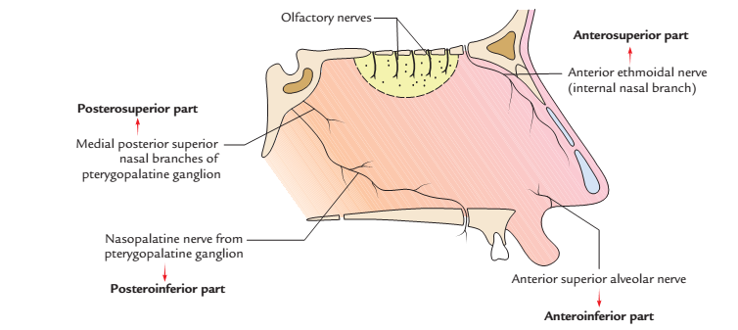
Cont’d
Nerve supply of the nasal septum

Slide 33
Arterial Supply of Lateral Wall
The arterial supply of the various parts of the lateral wall is as follows:
Anterosuperior quadrant, by the anterior ethmoidal artery, a branch of ophthalmic artery.
Anteroinferior quadrant, by branches of facial and greater palatine arteries.
Posterosuperior quadrant, by sphenopalatine artery, a branch of maxillary artery.
Posteroinferior quadrant, by branches of greater palatine artery, which pierces the perpendicular plate of palatine.

Slide 34
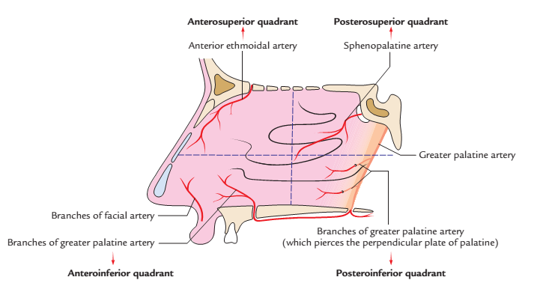
Cont’d
Arterial supply of the lateral wall

Slide 35
Nerve Supply of Lateral Wall
The following nerves supply the different parts of the lateral wall:
Olfactory nerves supply the upper part (one-third) just below the cribriform plate of ethmoid up to the superior concha.
Anterior ethmoidal nerve (from ophthalmic) supplies the anterosuperior quadrant.
Anterior superior alveolar nerve, a branch of infraorbital nerve (from maxillary) supplies the anteroinferior quadrant.
Posterior superior lateral branches, of pterygopalatine ganglion supply posterosuperior quadrant.
Nasal branches of greater palatine nerve, (from pterygopalatine ganglion) supply posteroinferior quadrant.

Slide 36
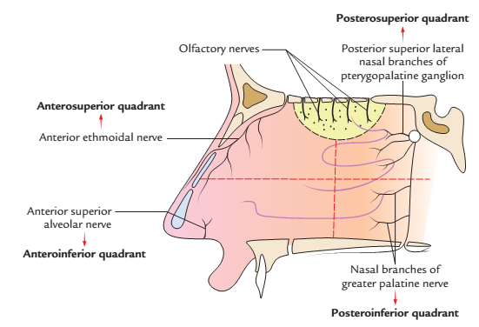
Cont’d
Nerve supply of the lateral wall of the nose

Slide 37
Venous Drainage of Nasal Cavity
The veins draining the nasal cavity form plexus beneath the mucosa and in general accompany the arteries. The veins of nasal cavity drain into Facial vein, Ethmoidal veins (and thus into the ophthalmic and dural veins), Sphenopalatine veins (and thus into the pterygoid venous plexus, and maxillary vein).

Slide 38
Lymphatic Drainage of Nasal Cavity
Lymph from anterior part of the nasal cavity (both medial and lateral walls) is drained into submandibular lymph nodes, from posterior part into retropharyngeal lymph nodes, and Upper deep cervical lymph nodes; these, together with the retropharyngeal lymph nodes, drain the larger part of nasal mucosa.

Slide 39
Nerve Supply of Nasal Cavity
Olfactory nerves: They carry sense of smell from olfactory region of nasal cavity.
Nerves of general sensation: These are:
Anterior ethmoidal nerve,
branches of sphenopalatine ganglion, and
branches of infraorbital nerve.
They carry sensations of pain, touch, and temperature from respiratory region and vestibule of nasal cavity.

Slide 40
Cont’d
Autonomic nerves: Both parasympathetic and sympathetic fibres supplying nasal cavity are derived from Vidian’s nerve (nerve of pterygoid canal) through pterygopalatine ganglion.
The parasympathetic fibres supply nasal glands and control nasal secretion.
The sympathetic fibres, on stimulation, cause vasoconstriction.

Slide 41
APPLIED ANATOMY
Facial deformity may occur following fracture of nasal bones or injury to nasal cartilages, e.g. in auto crash.
In head injury, the cribriform plate of ethmoid may be fractured; this tears the meninges, thereby causing leakage of CSF into the nasal cavity-CSF rhinorhoea.
The nasal septum may deviate to one side rather than being in the median plane; this deformity may obstruct the nasal cavity.

Slide 42
Cont’d
Epistaxis (nose bleed) may occur; it usually occurs in the Kiesselbach’s area (anteroinferior part of the nasal septum just above the vestibule), owing to the rich anastomoses between the main vessels of the nasal cavity in the Kiesselbach’s area. This area of nasal septum is the commonest site of epistaxis (nose bleeding) in children and young adults.
Epistaxis may be indicative of certain clinical conditions, including nasal infections and high blood pressure.

Slide 43
Cont’d
Rhinitis: when the nasal cavity is inflamed, the nasal mucosa swells readily, owing to its rich vascularity; this condition may also obstruct the nasal cavity. The hypertrophy of mucosa over inferior concha is a common feature of allergic rhinitis. It presents clinically as: nasal blockage, sneezing, and water discharge from nose (rhinorrhea).

Slide 44
Thrombophlebitis of nasal veins may also spread to the facial and ophthalmic veins, cavernous sinus and medial pterygoid plexus.
Owing to the continuity of the nasal mucosa with those of adjacent regions, nasal infections may spread to (or from) these regions; such regions or structures include the lacrimal sac and conjunctiva (via the nasolacrimal duct), cranial meninges (via the foramina of the cribriform plate of ethmoid), pharynx (via the choana), tympanic cavity, (via the auditory tube), and paranasal sinuses (via the openings of these sinuses).

Slide 45


Slide 46
ANATOMY OF THE PARANASAL SINUSES
BY
DR.OJEWALE A.O

Slide 47
Outline
Intro’
Relations
Functions
Classification
Types
Blood supplies
Applied Anatomy

Slide 48
PARANASAL SINUSES
They are air-filled cavities produced by extension of the nasal mucuous membrane into the bones around the nasal cavities.
They vary in size and shape in different subjects.
They develop as mucosal diverticula of the main nasal cavity invading the adjacent bones.
They are lined by a pseudostratified ciliated columnar epithelium; their mucosa is thinner and less vascularized compared to that of the nasal cavity.

Slide 49
Cont’d
They communicate with the nasal cavity via foramina.
They are absent or rudimentary at birth.
They enlarge greatly during the formation of permanent teeth and after puberty.
They include the maxillary, frontal, sphenoidal, and ethmoidal air sinuses.

Slide 50
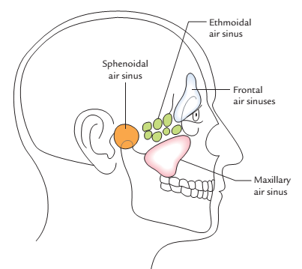
Cont’d
Positions of paranasal air sinuses on the surface: side view

Slide 51
Cont’d
There are four paranasal air sinuses on each side and are named after the bones containing them.
Frontal air sinuses present in the frontal bone.
Ethmoidal air sinuses present in the ethmoid bone.
Maxillary air sinuses present in the maxilla.
Sphenoidal air sinuses present in the sphenoid bone

Slide 52
Cont’d
They are arranged in pairs except the ethmoidal air sinuses, which are arranged in three groups, viz. anterior, middle, and posterior on each side.
The orbit of eye serves as a landmark to appreciate the location of various paranasal air sinuses.

Slide 53
Cont’d
The relationship of the paranasal sinuses to the orbit is as follows:
the frontal air sinus above,
the maxillary air sinus below,
the ethmoidal air sinus medial to, and
the sphenoidal air sinus behind the orbit.

Slide 54
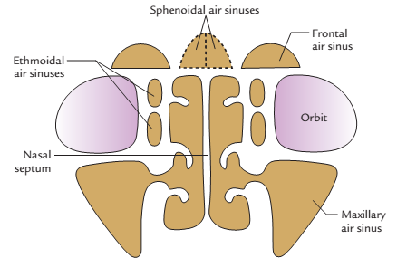
Cont’d

Slide 55
FUNCTIONS
Lighten the skull.
Help by adding resonance to the voice.
Act as an air conditioning chambers by adding humidity and temperature to the inspired air.
Aid in the growth of facial skeleton after birth.

Slide 56
CLASSIFICATION
Clinically, the sinuses are divided into the following two main groups:
Anterior group: It includes those sinuses, which drain into the middle meatus, viz. frontal, anterior and middle ethmoidal, and maxillary sinuses.
Posterior group: It includes those sinuses, which do not drain into the middle meatus, viz. posterior ethmoidal and sphenoidal air sinuses.

Slide 57
FRONTAL AIR SINUS
The frontal air sinus (two in number) lies between the inner and outer tables of the frontal bone above the superciliary arch and the root of the nose. They are triangular in shape.
The right and left frontal air sinuses are usually unequal in size and rarely symmetrical. The right is frequently larger than the left and separated from it by a septum.
Each sinus drains into the anterior part of the hiatus semilunaris of the middle meatus through frontonasal duct.

Slide 58
Cont’d
It appears rudimentary (or absent) at birth; however, it is well developed by the 7th year of life, and it reaches its full size after puberty.

Slide 59
Relations
Anterior wall is related to: superciliary arch of forehead
Posterior wall is related to: meninges and frontal lobe of the brain.
Inferior wall is related to: roof of nose, roof of orbit (medial part), and ethmoidal air cells.

Slide 60
Cont’d
Arterial Supply
It is by the anterior ethmoidal, and supraorbital arteries from the ophthalmic artery.
Venous drainage
Its veins drain into the anastomotic vein in the supraorbital notch.
Nerve Supply
It receives sensory fibres from the supraorbital nerve.
Lymphatic Drainage
The sinus drains into submandibular lymph nodes.

Slide 61
MAXILLARY SINUS (ANTRUM OF HIGHMORE)
It is the large pyramidal cavity located in the body of the maxilla; It is the largest of the paranasal air sinuses.
It has an apex, a base, a roof, and a floor.
It drains into the hiatus semilunaris (posterior part) of the middle meatus.
Shape
It is pyramidal in shape with the base directed medially towards the lateral wall of the nose and its apex laterally towards the zygomatic bone.

Slide 62
Cont’d
It appears as a minute groove on the medial aspect of the maxilla in the 4th month of intrauterine life.
It grows slowly prior to puberty; however, it enlarges rapidly in the postpubertal period, and reaches its full size after the eruption of all permanent teeth.

Slide 63
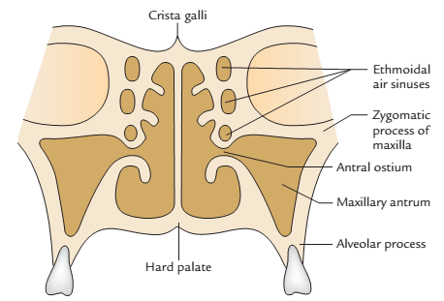
Cont’d
Relations of maxillary sinus

Slide 64
Relations
Apex extends into the zygomatic process of the maxilla.
Base is formed by the lower part of the lateral wall of the nose. It possesses the opening or ostium of the sinus in its upper part, i.e., close to the roof, a disadvantageous position for natural drainage.

Slide 65
Cont’d
Roof is formed by the floor of the orbit. The infraorbital nerve and artery traverse the roof in a bony canal.
Floor (very small) is formed by the alveolar process of maxilla and lies about 1.25 cm below the floor of the nasal cavity. The level of the floor corresponds to the level of the ala of nose. Normally, the roots of the first and second molar teeth project into the floor producing elevations but sometimes roots of the first and second premolars, third molar, and rarely even that of canine may project into the floor.

Slide 66
Cont’d
Anterior wall is formed by the anterior surface of the body of maxilla and is related to infraorbital plexus of nerves. Within this wall runs the anterior superior alveolar nerve in a curved bony canal called canalis sinusus.
Posterior wall is formed by the infratemporal surface of the maxilla, separating the sinus from the infratemporal and pterygopalatine fossae. It is pierced by the posterior superior alveolar nerves and vessels.

Slide 67
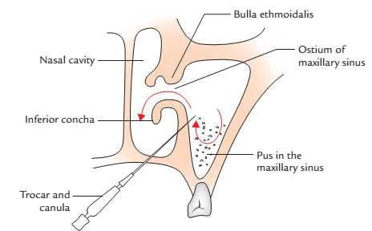
Opening
Maxillary sinuses open in the hiatus semilunaris of middle meatus near the roof of the sinus.
Antral puncture (antrostomy)

Slide 68
Arterial Supply
It is by the anterior, middle, and posterior superior alveolar arteries from maxillary and infraorbital arteries.
Venous Drainage
Veins which drain the maxillary sinus accompany the corresponding arteries.
Nerve Supply
Maxillary sinuses are supplied by the anterior, middle, and posterior superior alveolar nerves from the maxillary and infraorbital nerves.
Lymphatic Drainage
The sinus drains into submandibular lymph nodes.

Slide 69
ETHMOIDAL SINUSES
The ethmoidal air sinuses are thin-walled cavities located in the labyrinth of ethmoidal bone, thus they are located between the upper part of the lateral nasal wall and the orbit.
They consist of several minute intercommunicating cavities- the ethmoidal air cells.
They are divided into the following three groups: Anterior, consisting of up to 11 cells. Middle, consisting of 1–3, usually three cells. Posterior, consisting of 1–7 cells.

Slide 70
Cont’d
They extend variably into the adjoining frontal, sphenoidal, maxillary, lacrimal, and palatine bones.
The first two groups-anterior and middle drain into the middle meatus (anterior opens in the hiatus semilunaris and middle on the surface of bull ethmoidalis) and the posterior into posterior part of superior meatus.

Slide 71
Ethmoidal sinuses are supplied by branches of the anterior and posterior ethmoidal, and sphenopalatine arteries.
Veins which correspond to the above arteries drain the ethmoidal sinuses.
Ethmoidal sinuses receive sensory fibres from the anterior and posterior ethmoidal nerve (from the nasociliary branch of ophthalmic nerve).
The anterior and middle ethmoidal sinuses are drained by the submandibular nodes, while the posterior ethmoidal sinus is drained by the retropharyngeal nodes.

Slide 72
SPHENOIDAL SINUS
It is located in the body of the sphenoid bone above and behind the nasal cavity.
They are separated from each other by a bony septum.
The two sinuses are usually asymmetrical.
Each sinus drains into the sphenoethmoidal recess of the nasal cavity via an aperture.
It may be replaced, to a large extent, by an extension of the posterior ethmoidal sinus into the sphenoidal bone.

Slide 73
Cont’d
It appears as a small groove by the 5th month of intrauterine life, and as a minute cavity at birth.
It extends into the body of the sphenoid by the 7th or 8th year of life , and it is well developed after the puberty.

Slide 74
Relations
Above: Pituitary gland, optic chiasma, and olfactory tract.
Below: Roof of the nasopharynx and posterior part of the nasal cavity.
Lateral: Cavernous sinus and internal carotid artery (on each side), and optic nerve (optic canal).
Behind: Pons and medulla oblongata.
In front: Sphenoethmoidal recess

Slide 75
Cont’d
Regarding its vasculature, lymphatics, and innervation, the sphenoidal sinus is
Supplied by the posterior ethmoidal arteries.
Drained by the posterior ethmoidal veins
Innervated by the posterior ethmoidal nerve.
Drained by lymph vessels that end in the retropharyngeal lymph nodes.

Slide 76
APPLIED ANATOMY
Sinusitis: Is the inflammation of one or more of the sinuses; when this occurs, the mucosa of the sinus becomes swollen, and painful and its opening may be blocked.
The maxillary and frontal sinuses can be examined (for a growing mass or the presence of fluid) by transillumination.
The ethmoidal and sphenoidal sinuses can not be examined by transillumination.

Slide 77
Cont’d
Infections of the nasal cavity could invade the paranasal sinuses owing to the continuity of their mucosa; due to a similar reason, infections of the conjuctival and lacrimal apparatus could also affect these sinuses.
Owing to the proximity of the posterior ethmoidal sinus to the optic nerve, infections of this sinus may affect the nerve, causing optic neuritis this may result in blindness.

Slide 78
Cont’d
Pus in the frontal and anterior ethmoidal sinuses could flow , via the ethmoidal infundibulum, into the hiatus semilunaris, and hence, into the maxillary sinus. When it accumulates in the maxillary sinus does not drain readily owing to the high position of the ostium of the sinus; drainage may however be effected by puncturing the canine fossa on the anterior aspect of the maxilla.
Drainage of maxillary sinus: The opening of this sinus is unfortunately located in the upper part of the lateral wall of nose, which is a disadvantageous site for adequate natural drainage.

Slide 79
Cont’d
Maxillary sinusitis: Maxillary sinus is most commonly infected of all the sinuses due to following reasons: Infection can reach into this sinus from infected nose (viral rhinitis), carious upper premolar and molar teeth, especially molars, and infected frontal and anterior ethmoidal sinuses.
Carcinoma of maxillary sinus: It arises from the mucous lining of the sinus.

Slide 80
Cont’d
Involvement of infraorbital nerve produces pain and anesthesia in the skin over the face below the orbit.
The upward invasion into the orbit displaces the eyeball causing proptosis (protrusion of eyeball) and diplopia (double vision).
The downward invasion into the floor produces visible bulge or even ulceration of palatal roof of the oral cavity.

Slide 81
Cont’d
The medial invasion encroaches the nasal cavity causing obstruction and epistaxis. The obstruction of nasolacrimal duct in this wall produces epiphora (overflow of tears).
The lateral invasion produces swelling on the face and palpable mass in the gingivolabial fold (groove).

Slide 82


Slide 83
THANK YOU, ALL FOR LISTENING.

